Slide 1
For Reg. No 181IT245, 191IT101-191IT212
Test Cases for IT352-Lab-Program-2 for First Set of Students
Text Cases are as follows:
www.elsevier.com
https://www.iitb.ac.in/
https://www.nitk.ac.in/
https://iitd.ac.in/
www.ibm.org

Slide 2
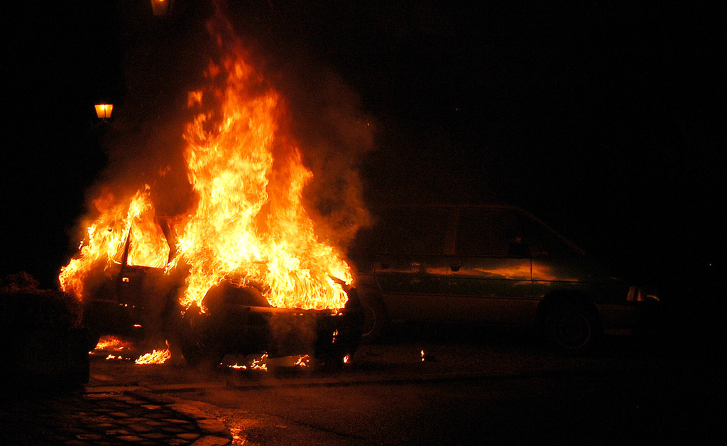


Test Cases for IT352-Lab-Program-2 for Second Set of Students
For Reg. No 191IT213 - 191IT258
Text Case-1
Text Case-2
Text Case-3

Slide 3
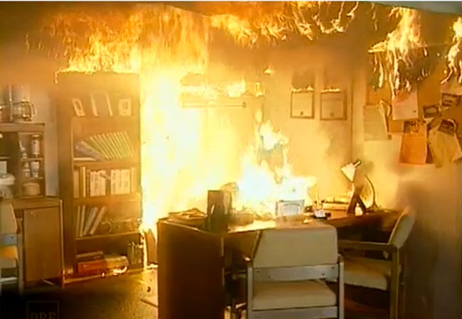
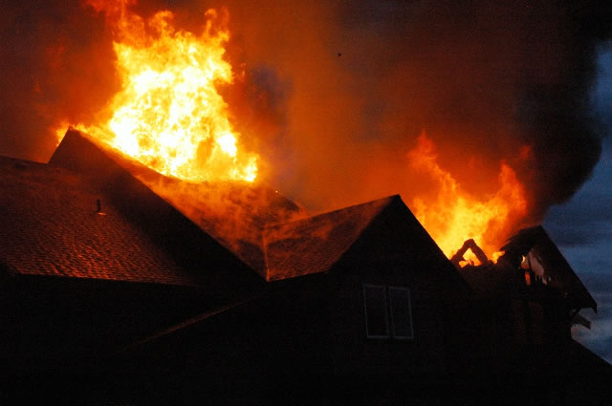
Test Cases for IT352-Lab-Program-2 for Second Set of Students
For Reg. No 191IT213 - 191IT258
Text Case-4
Text Case-5

